Slide 1


Amit Jain
September 24, 2022

Slide 2

Outline
Executive Summary
Introduction
Methodology
Results
Conclusion
Appendix

Slide 3
Executive Summary
The project provides insights on the different feature that affect the rocket launching outcomes.
Predictive model is developed to predict the outcome of the future launch based of various characteristic of the flight which includes launch site, booster version, payload mass, etc.
Payload mass, orbit, launch site, booster version are key parameters that requires attention in the future launching
Decision tree model predict the outcome with significantly good accuracy

Slide 4
Introduction
The project provides insights on the different feature that affect the rocket launching outcomes.
Predictive model is developed to predict the outcome of the future launch based of various characteristic of the flight which includes launch site, booster version, payload mass, etc.

Slide 5

Section 1

Slide 6
Methodology
Executive Summary
Data collection methodology:
API calls and webscrping are used for data collection
Perform data wrangling
Key features are used in the predictive analysis and classification features are converted into a numeric ones.
Perform exploratory data analysis (EDA) using visualization and SQL
Perform interactive visual analytics using Folium and Plotly Dash
Perform predictive analysis using classification models
Models are build by tuning hyper parameters using GridSearchCV algorithm and then assessed for accuracy by dividing the dataset into training and testing sets.

Slide 7
Data Collection
Data sets were collected using two methods
Calling API
Web scraping
API calls are by requesting response, modifying data using .json file and converting into a dataframe
In web scraping, Wikipedia webpage is used to obtain information using ‘html’ parsing and then converting into a dataframe.

Slide 8
Data Collection – SpaceX API
Get response by requesting the URL
Decode through .json file
Filter data and query details
Booster version
Payload mass
Launchpad
Landing outcome
Response in data frame
Get data from URL
Present your data collection with SpaceX REST calls using key phrases and flowcharts
Add the GitHub URL of the completed SpaceX API calls notebook (must include completed code cell and outcome cell), as an external reference and peer-review purpose
https://github.com/jain651/spacex_stage1_landing/blob/main/w1_collection_api.ipynb

Slide 9
Data Collection - Scraping
Get response with beautiful soup
Parse the webpage using HTML parser
Extract table rows into data frame
Required data frame
Extract required table
Get data from SpaceX wiki page
Present your web scraping process using key phrases and flowcharts
Add the GitHub URL of the completed web scraping notebook, as an external reference and peer-review purpose
https://github.com/jain651/spacex_stage1_landing/blob/main/w1_webscraping.ipynb

Slide 10
Data Wrangling
At first the fraction of null values, data types were evaluated.
Number of different orbits, launching sites, landing outcomes were extracted
The landing outcomes were reduced binary class: ‘successful’ or ‘failure’
GitHub URL: https://github.com/jain651/spacex_stage1_landing/blob/main/w1_wrangling.ipynb

Slide 11
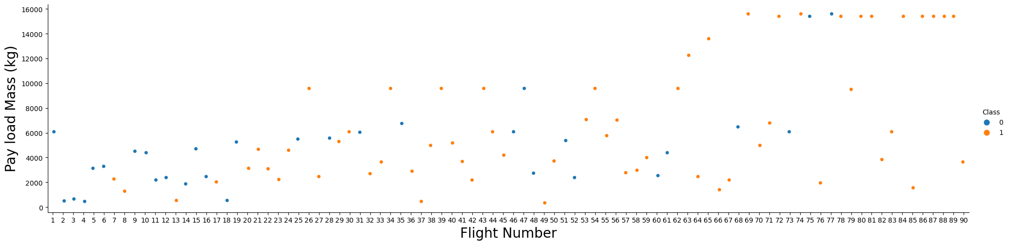
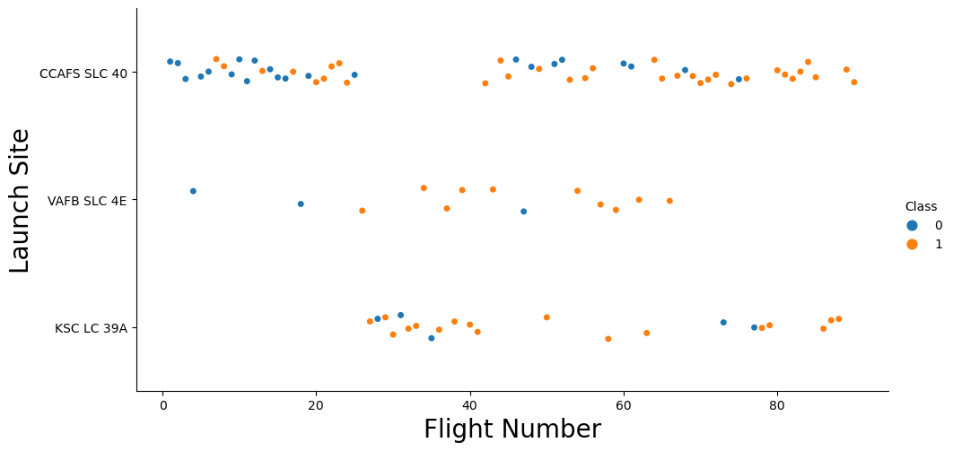
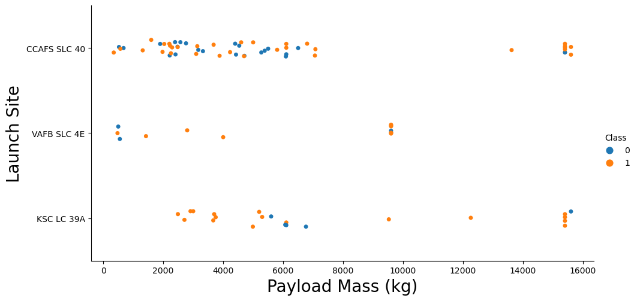
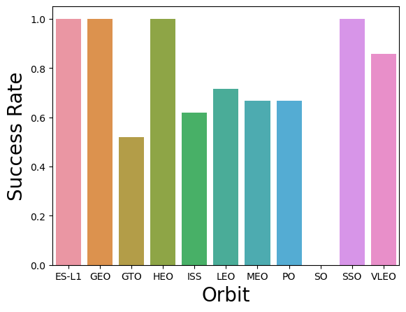
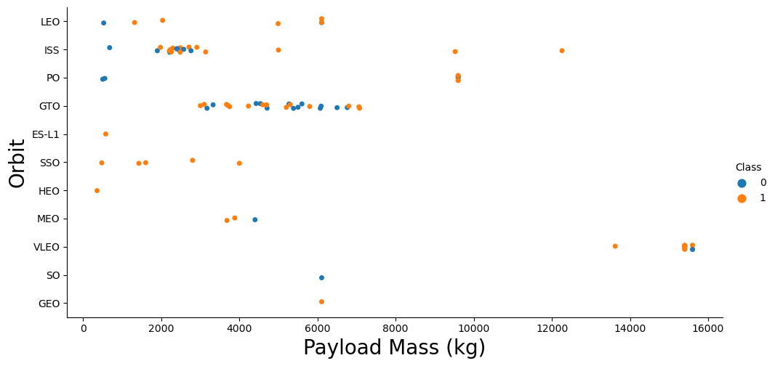
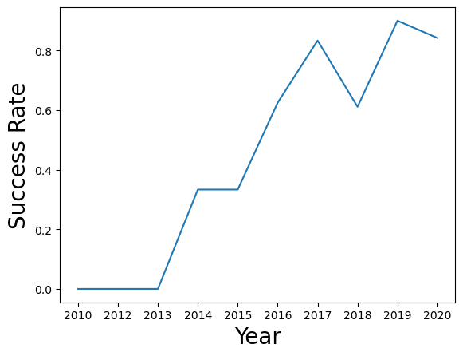
EDA with Data Visualization
Different features were plotted against each other to identify relationship between them
One hot coding were done to replace categorical features into numerical
GitHub URL: https://github.com/jain651/spacex_stage1_landing/blob/main/w2_eda_dataviz.ipynb

Slide 12
EDA with SQL
Following SQL queries were performed to evaluate:
Distinct launch sites
Records where launch sites begin with 'CCA’
Total payload mass carried by boosters launched by NASA (CRS)
Average payload mass carried by booster version F9 v1.1
Date when the first successful landing outcome in ground pad was achieved
List boosters having success in drone ship with payload between 4000 and 6000 kg
Total number of successful and failure mission outcomes
The booster versions that have carried the maximum payload mass
Records for year 2015 displaying the month names, failure landing outcomes in drone ship, booster versions, and launch_site
Rank the successful landing outcomes between 04-06-2010 and 20-03-2017
GitHub URL: https://github.com/jain651/spacex_stage1_landing/blob/main/w2_eda_sqllite.ipynb

Slide 13
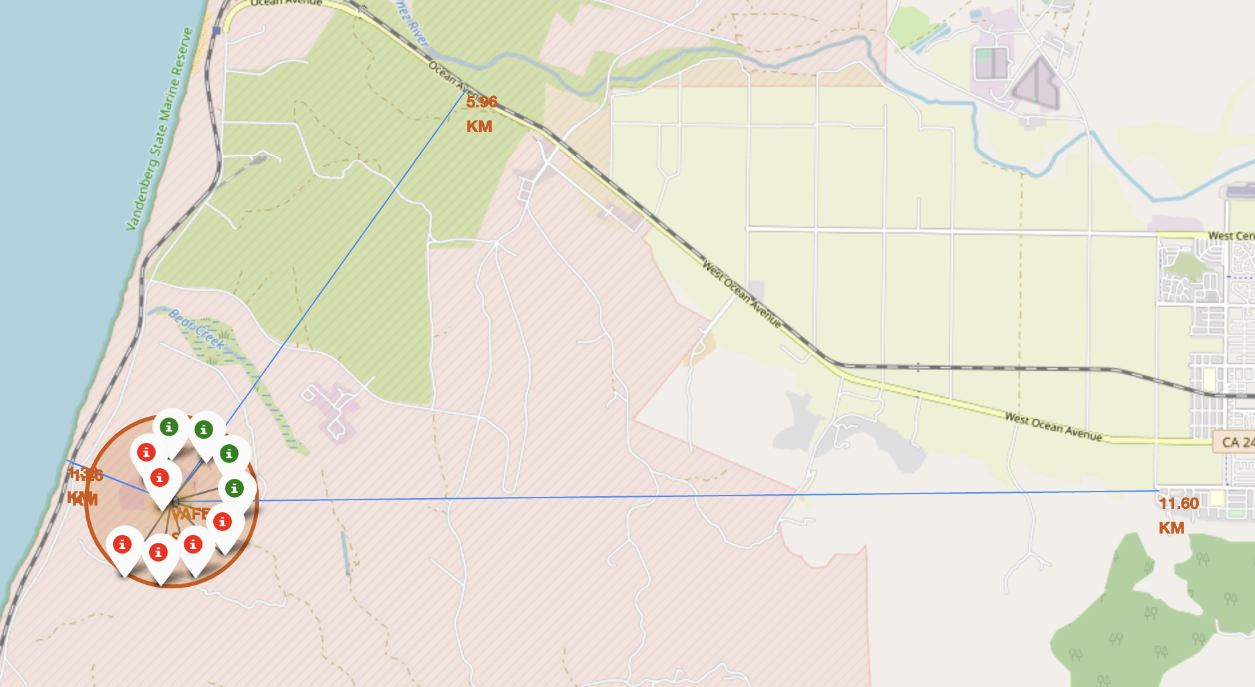
Build an Interactive Map with Folium
Folium map is created to show launch sites their distances from nearest coastline, city, highway, and railway using following objects:
Markers
Circles
Lines
These object quickly shows number of successful and failure attempts from each launching sites
GitHub URL: https://github.com/jain651/spacex_stage1_landing/blob/main/w3_folium_viz.ipynb

Slide 14
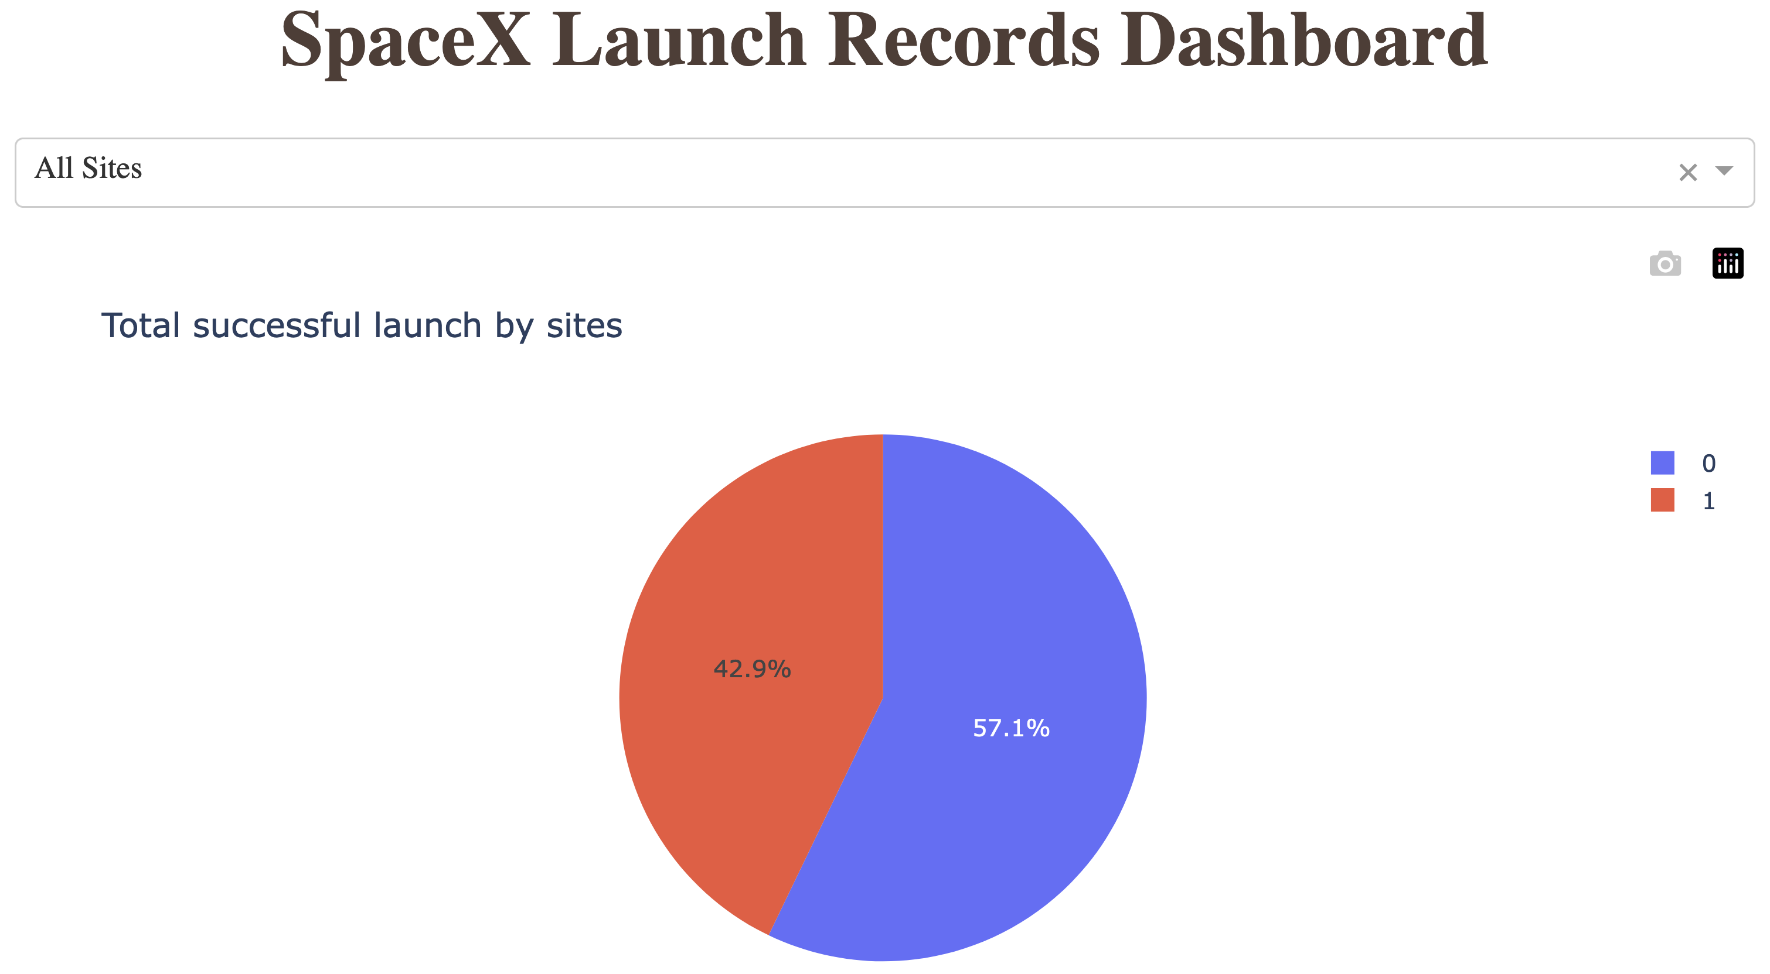
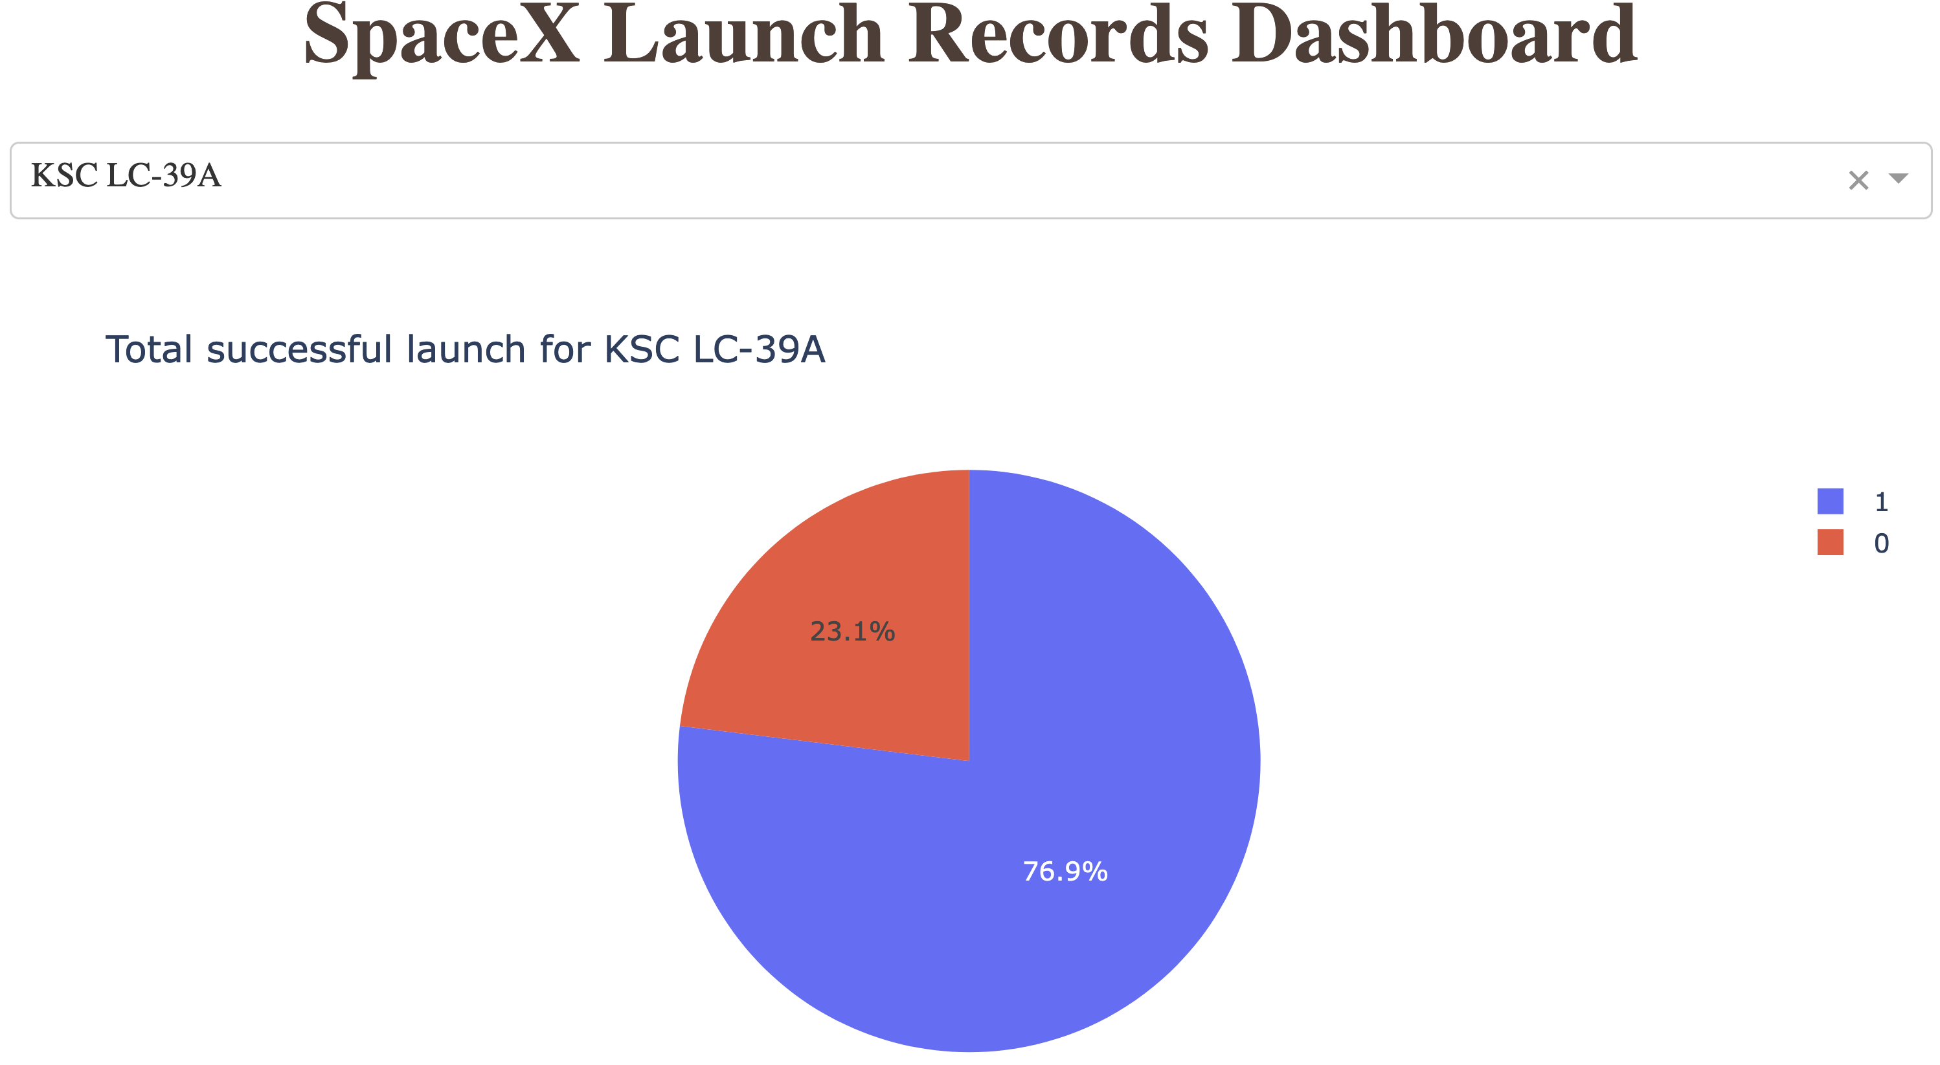
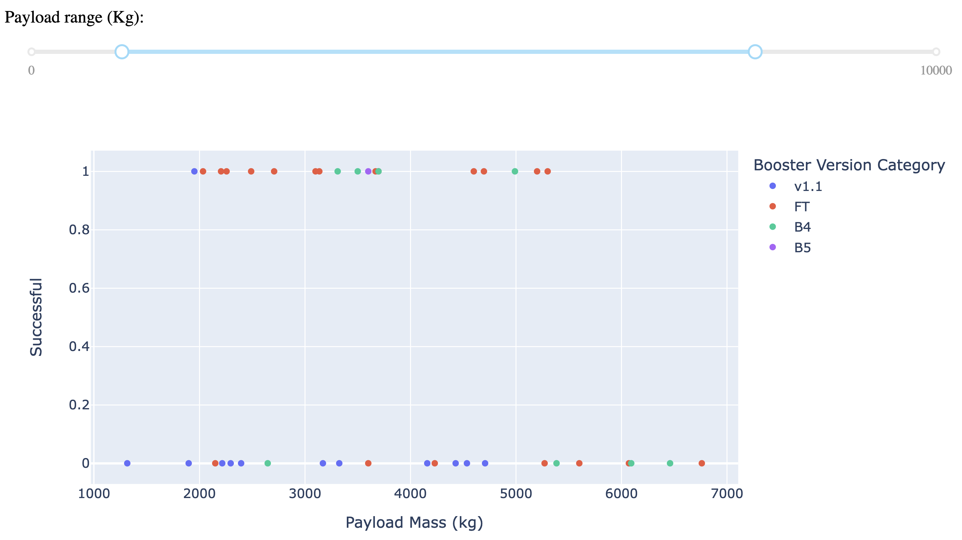
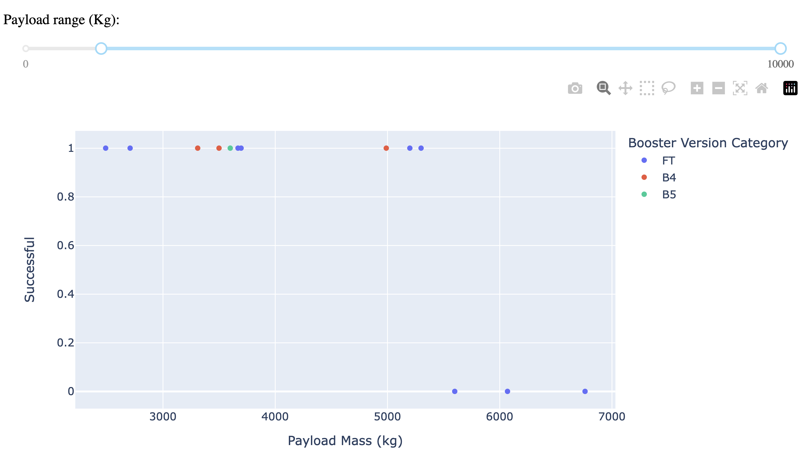
Build a Dashboard with Plotly Dash
A glance on
Success rate for each launch site and all launch sites
Effect of payload mass on success and indication of the booster version category
Dashboard is required to visually identify effectiveness of the launch site, payload mass and booster version on success.
GitHub URL: https://github.com/jain651/spacex_stage1_landing/blob/main/w3_plotly_dash.py

Slide 15
Predictive Analysis (Classification)
Standardization and transformation
Ready to use data in model
Division of data
Train and test sets
Selection of models and hyperparameters
Best parameters
Four models
Accuracy assessment
Identification of best model
Following models were examined
Logistic Regression
Support Vector Machine
Decision Tree
k-Nearest Neighbor
GridSearchCV was used to identify best hyperparameters for each model
Decision tree was found to provide best prediction with 86% accuracy
GitHub URL: https://github.com/jain651/spacex_stage1_landing/blob/main/w4_prediction.ipynb

Slide 16
Results
Payload mass affect the accuracy of the results
Success rate has significantly increased after 2014.
Decision tree model provides best accuracy with 86%

Slide 17

Section 2

Slide 18
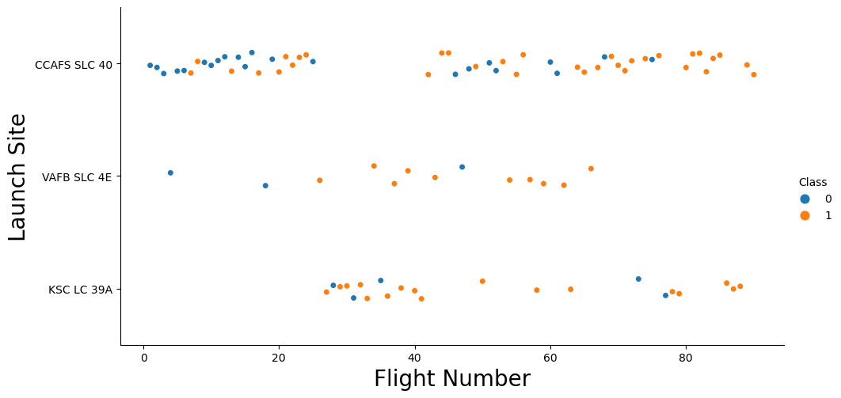
Flight Number vs. Launch Site
Initial flights are mostly launched from CCAFS SLC 40.
Most of the flights are launched from CCAFS SLC 40.
KSC LC 39A has most successful launches.

Slide 19
Payload vs. Launch Site
Payload mass > 8000 kg has been most successful.
Launch with heavy payload mass are done at either CCAFS SLC 40 or KSC LC 39A.

Slide 20
Success Rate vs. Orbit Type
SO orbit has the least success rate followed by the GTO.
ES-L1, GEO, HEO and SSO shows 100% success rate

Slide 21
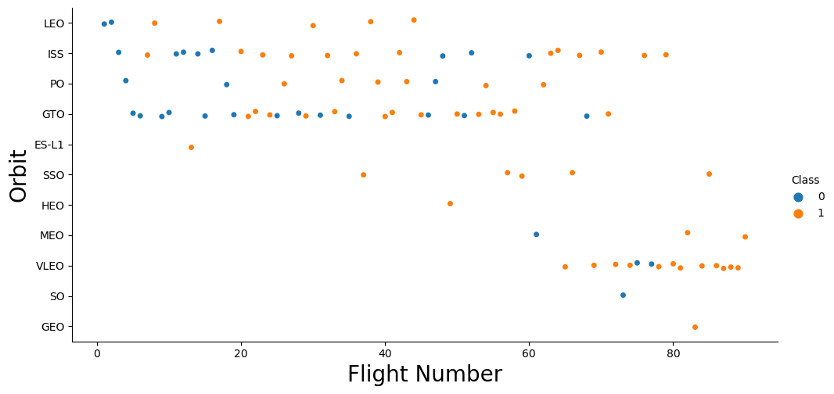
Flight Number vs. Orbit Type
100% success rate obtained in ES-L1, GEO, HEO and SSO is derived from very limited number of flights.
Similarly, least success rate with SO is derived from only one flight.
Recent flights are mostly targeted towards VLEO while initial flights were targeted towards LEO, ISS, GTO.

Slide 22
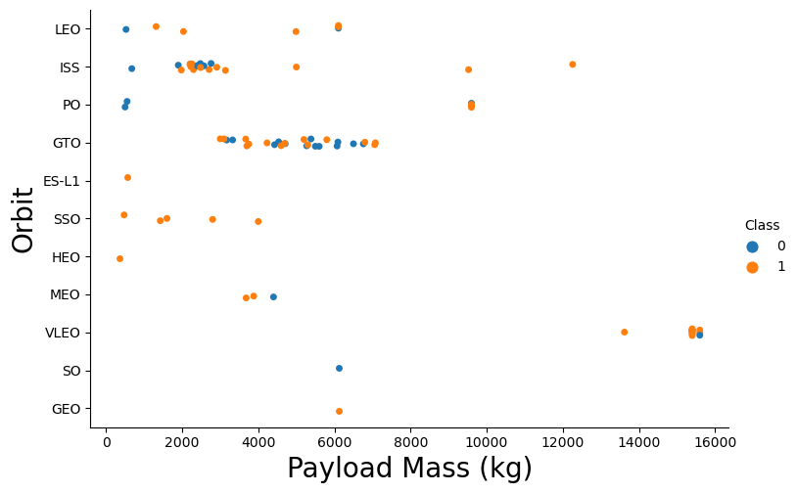
Payload vs. Orbit Type
Heavy payload (>13000 kg) are sent to VLEO and are successful.
Lighter payloads are mostly sent to SSO, GTO, ISS and LEO.

Slide 23
Launch Success Yearly Trend
Success rate is significantly increasing since 2014.
Success rate is about 80% in recent years

Slide 24
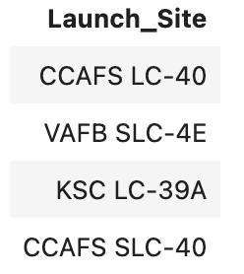
All Launch Site Names
Unique launch site names are
They are spatially located at mainly 3 geo-locations.

Slide 25
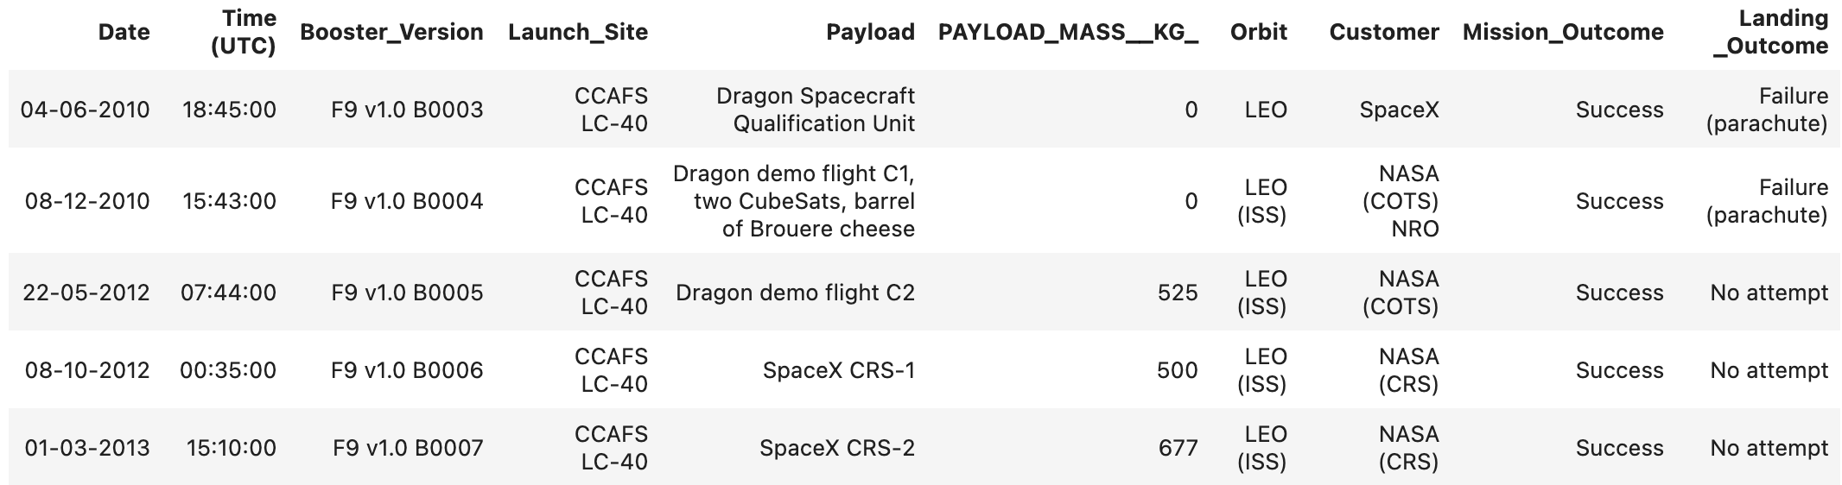
Launch Site Names Begin with 'CCA'
5 records where launch sites begin with `CCA`
These are just 5 records, but other sites that begins with `CCA` can be obtained.

Slide 26
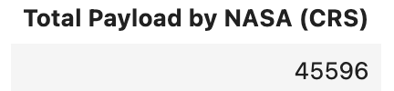
Total Payload Mass
Calculate the total payload carried by boosters from NASA
Total payload mass by customer = NASA (CRS)

Slide 27
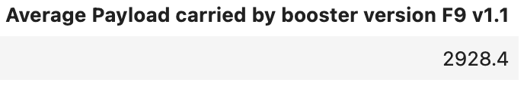
Average Payload Mass by F9 v1.1
Calculate the average payload mass carried by booster version F9 v1.1
Average of the payload mass when booster_version = booster version F9 v1.1

Slide 28
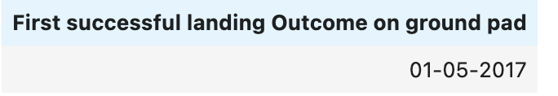
First Successful Ground Landing Date
Find the dates of the first successful landing outcome on ground pad
First successful landing for successful landing on ground pad

Slide 29
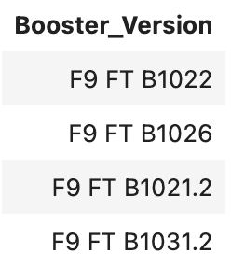
Successful Drone Ship Landing with Payload between 4000 and 6000
List the names of boosters which have successfully landed on drone ship and had payload mass greater than 4000 but less than 6000
Names of the boosters that have successfully landed on drone ship with payload mass in between 4000 and 6000 kg.

Slide 30
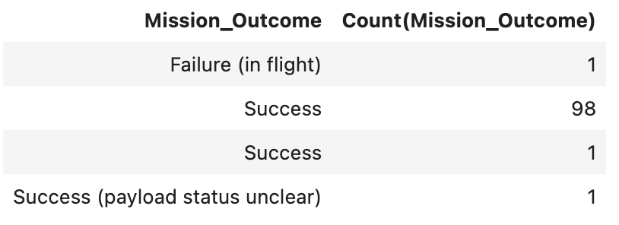
Total Number of Successful and Failure Mission Outcomes
Calculate the total number of successful and failure mission outcomes
Number of time the mission outcome occurs

Slide 31
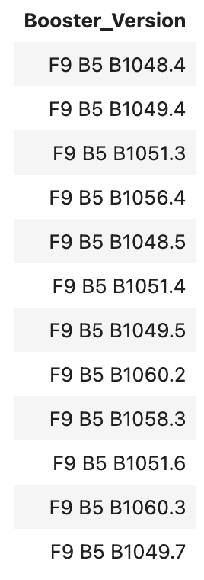
Boosters Carried Maximum Payload
List the names of the booster which have carried the maximum payload mass
List of boosters that have carried the maximum payload mass

Slide 32
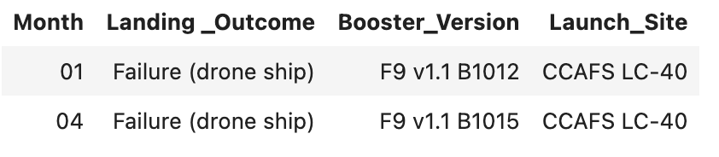
2015 Launch Records
List the failed landing_outcomes in drone ship, their booster versions, and launch site names for in year 2015
When flight landing failed on the drone ship with booster version and launch site names.

Slide 33
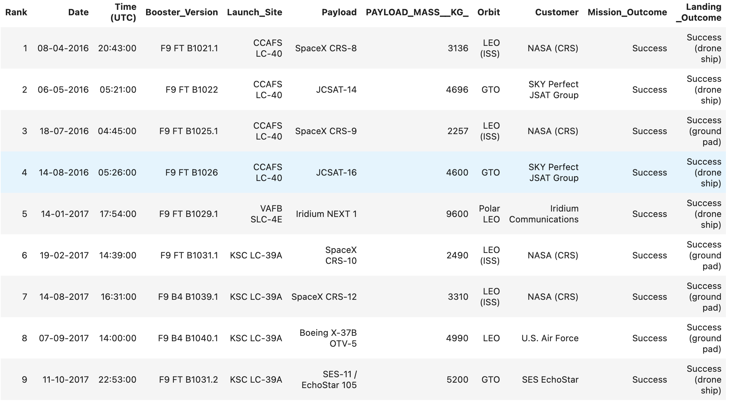
Rank Landing Outcomes Between 2010-06-04 and 2017-03-20
Rank the count of landing outcomes (such as Failure (drone ship) or Success (ground pad)) between the date 2010-06-04 and 2017-03-20, in descending order
Ranking in the descending order of all flights between 2010-06-04 and 2017-03-20 with success on ground pad.

Slide 34

Section 3

Slide 35
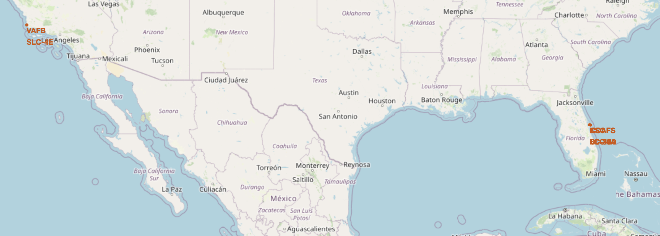
Launching sites on map
Launch sites are shown on map in red color texts.

Slide 36
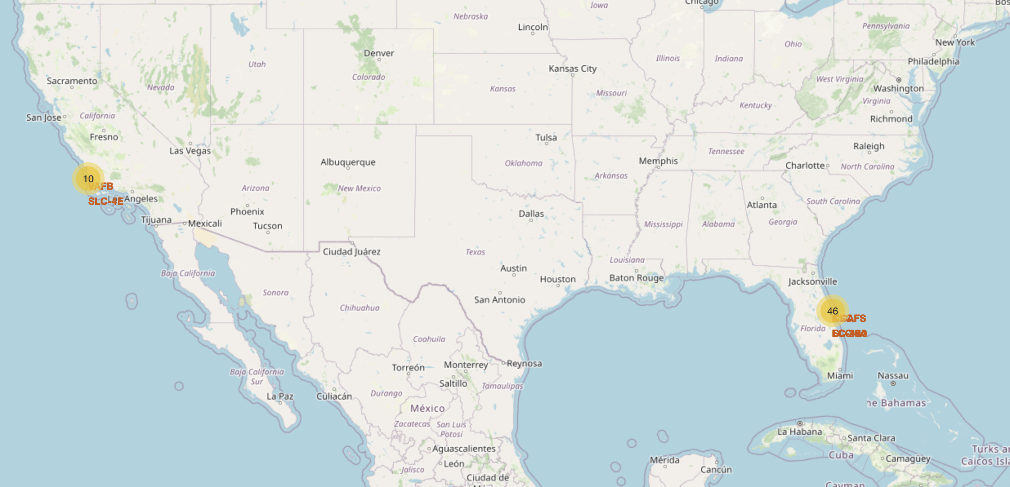
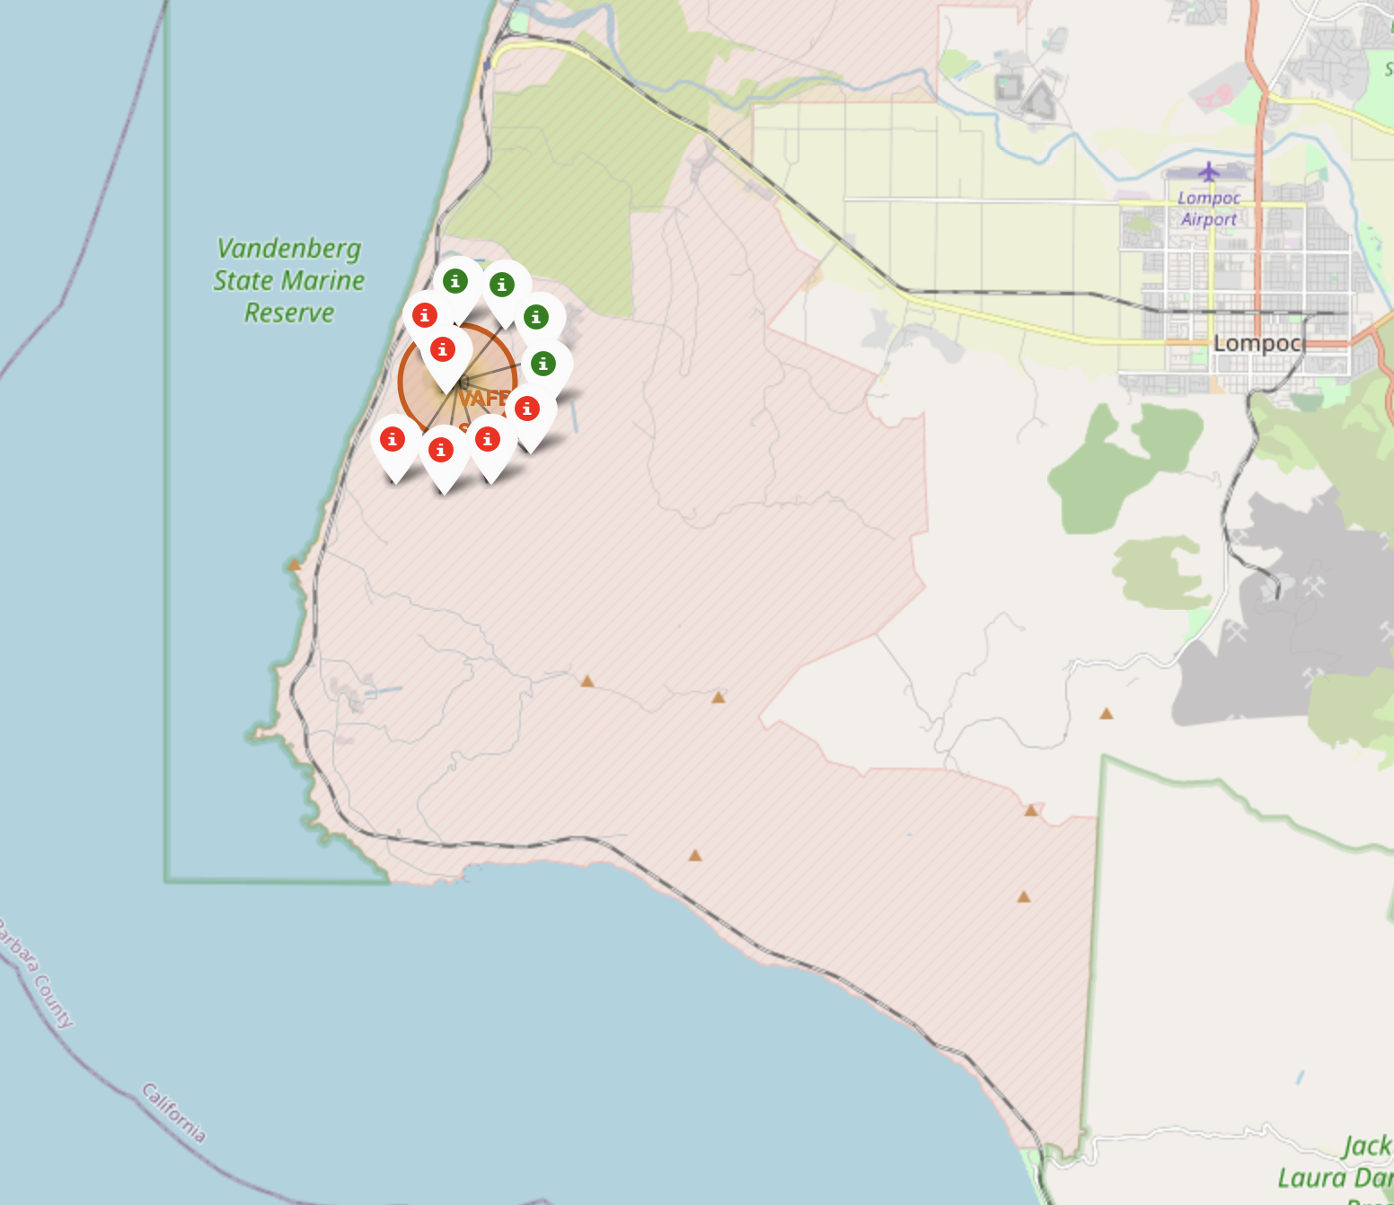
Launching sites with launch outcome markers
Number of launch attempts are shown in yellow circle.
Markers are shown in red and green color representing the failed and success outcome, respectively.

Slide 37
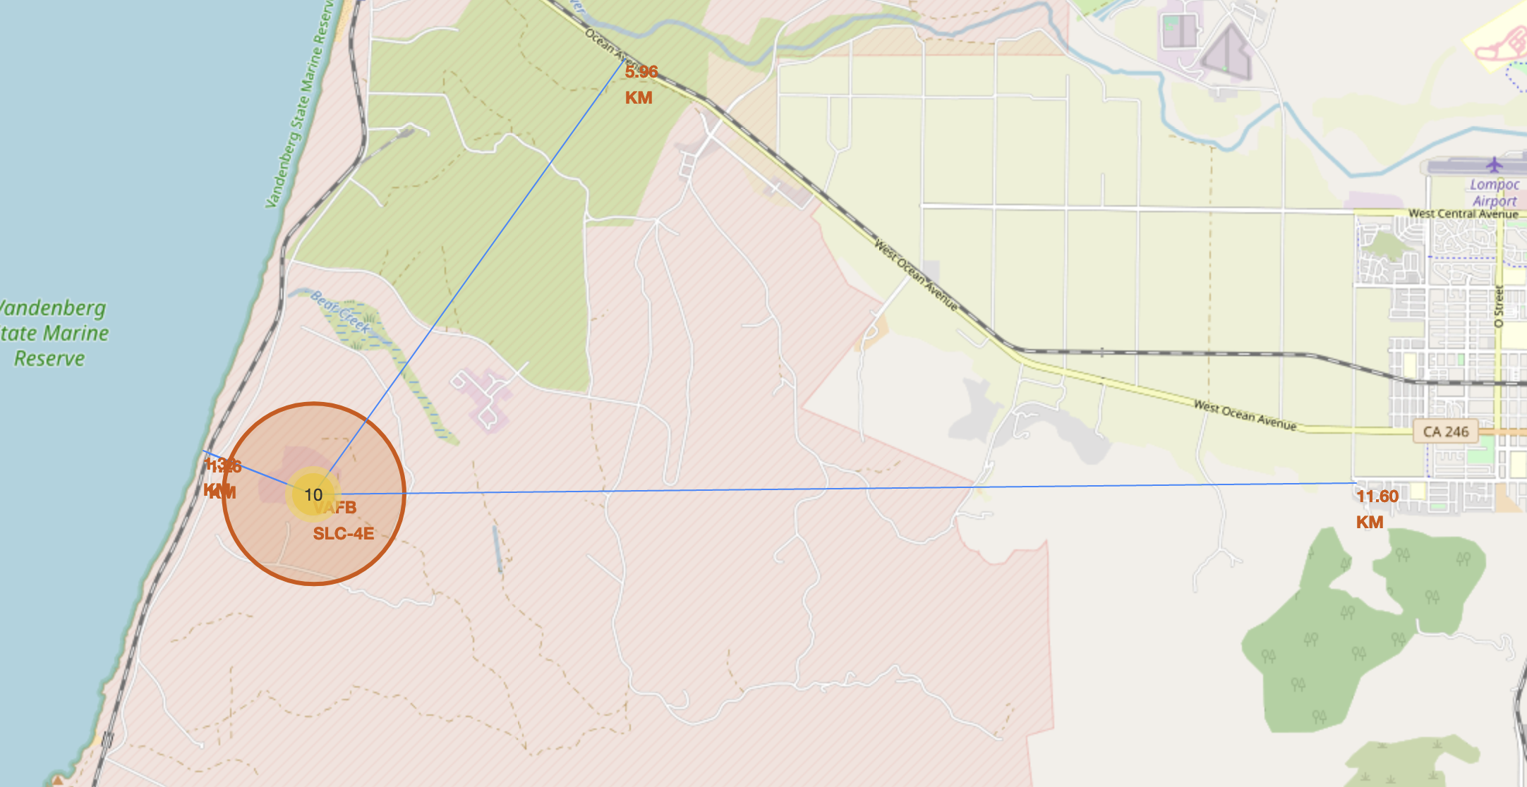
Launch site with distance to important elements
Distance from the important elements are shown in the map with their location
Blue line represent minimum distance from the important features.

Slide 38

Section 4

Slide 39
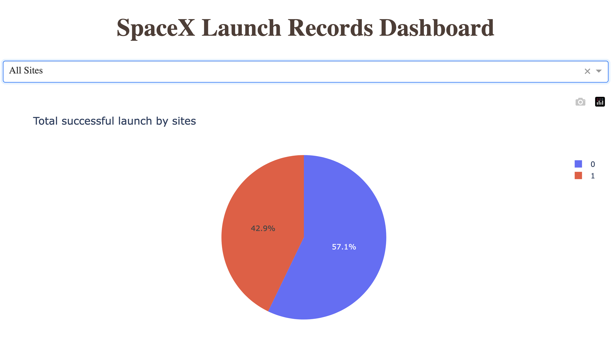
Successful launch by all sites
Successful launch fraction is shown in red color in the pie chart.

Slide 40
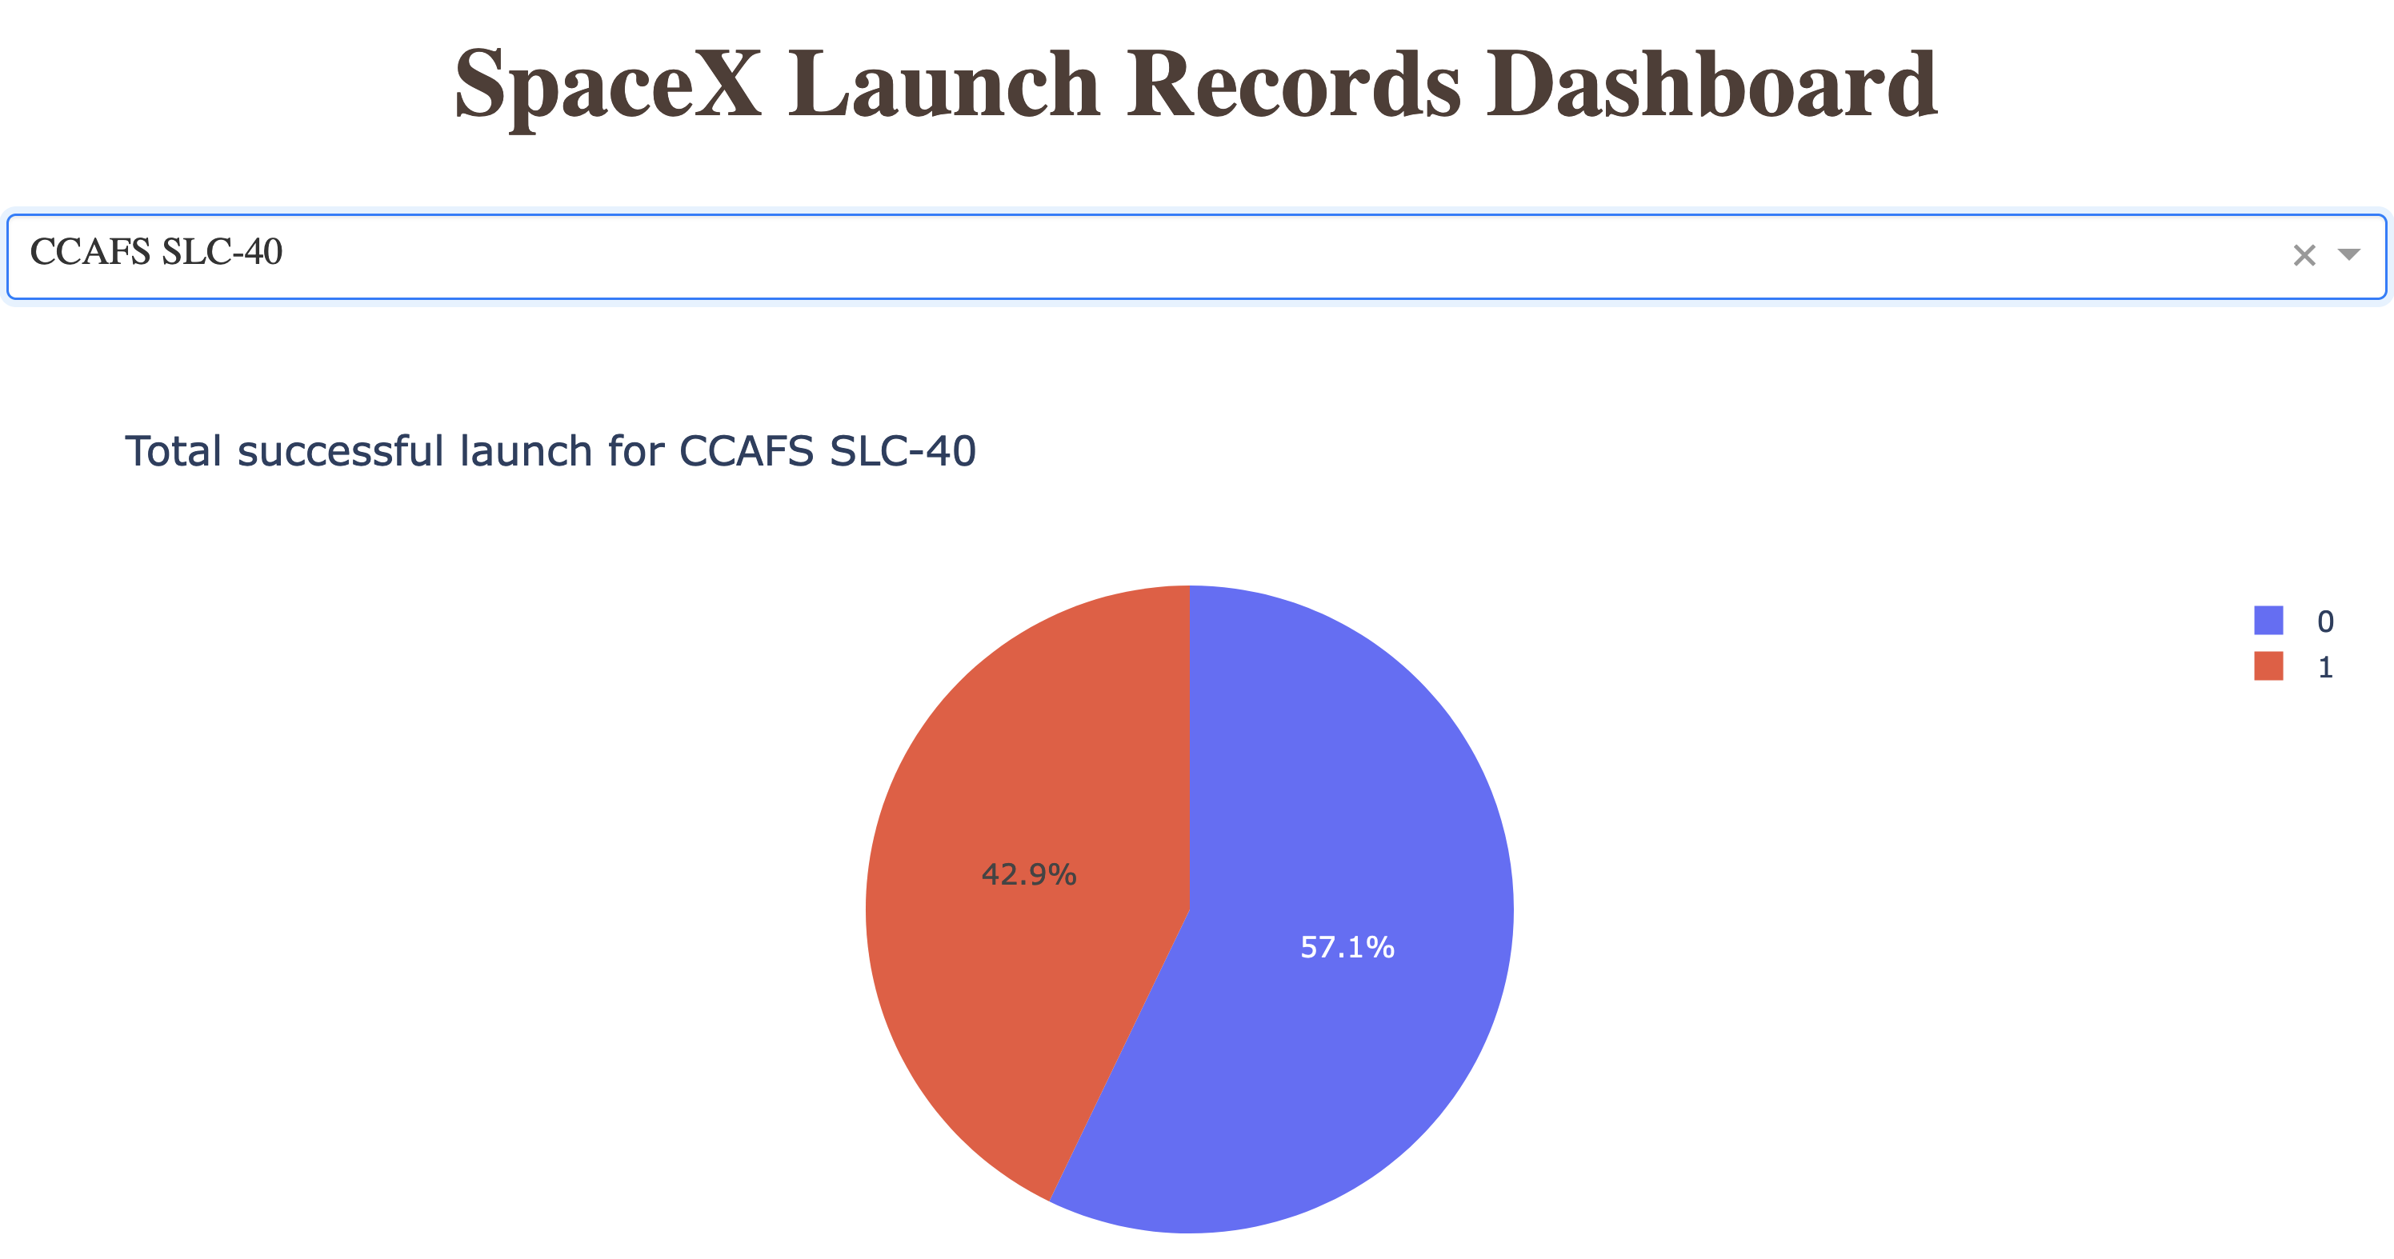
Site with highest success rate
Launch from CCAFS SLC-40 has the highest success rate of 42.9 %

Slide 41
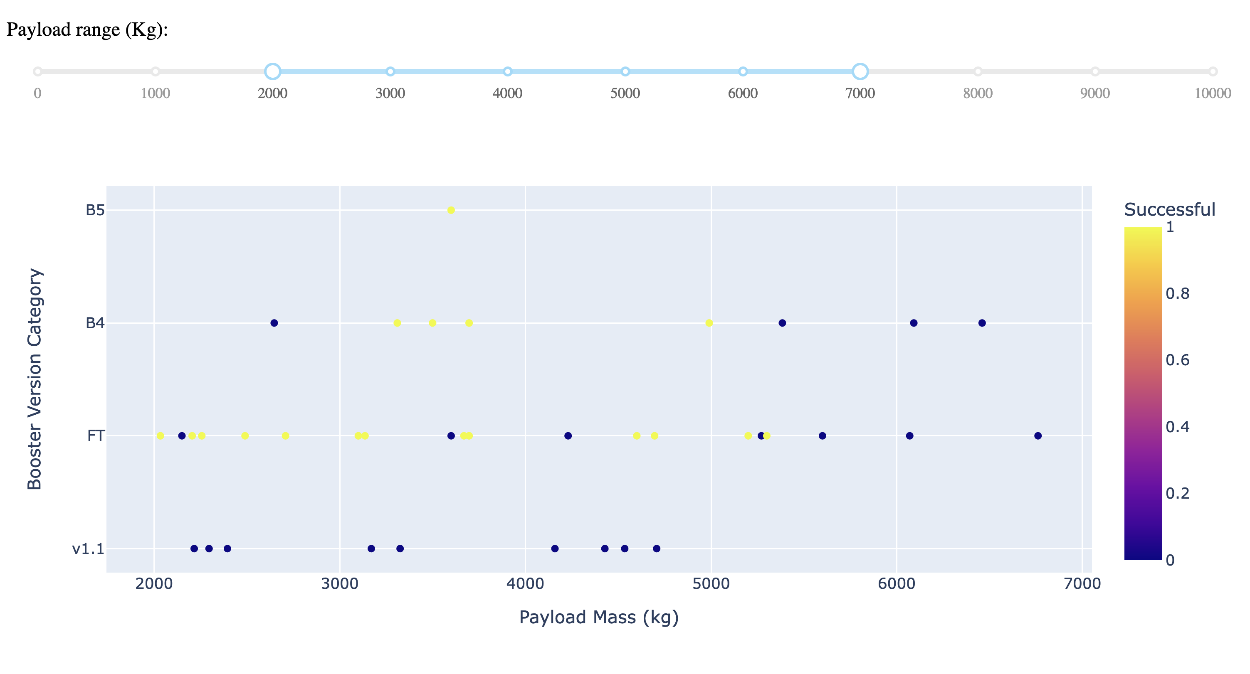
Payload mass vs Booster version
For payload mass between 2000 and 7000 kg, Booster version with category ‘FT’ has highest success rate.

Slide 42

Section 5

Slide 43
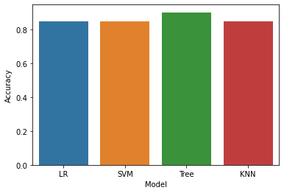
Classification Accuracy
Decision Tree has the best prediction accuracy for this classification problem

Slide 44
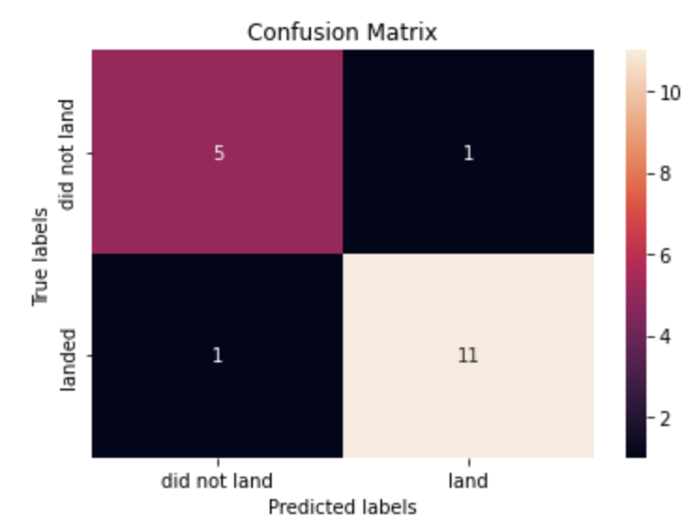
Confusion Matrix
Confusion matrix for the decision tree model.
It shows that the number of cases for both false positive and false negative are very less as compared to true positive and true negative cases.

Slide 45
Conclusions
Payload mass, orbit, launch site, booster version are key parameters that requires attention in the future launching
Decision tree model predict the outcome with significantly good accuracy

Slide 46


